Slide 1
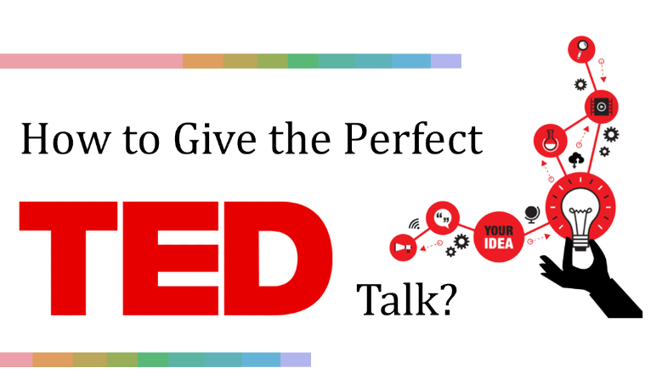
By:
Hossam El-Din Sayed Hassan 171700
Menna Allah Sayed Mostafa 171723

Slide 2


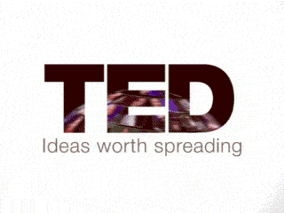
Background and Motivation
TED is a non-profit organization devoted to spreading ideas, usually in the form of short, powerful talks (18 minutes or less).
TED began in 1984 as a conference where Technology, Entertainment and Design converged, and today covers almost all topics — from science to business to global issues — in more than 100 languages.
Since June 2006, TED Talks have been offered for free viewing online, under an Attribution-Noncommercial-No Derivatives Creative Commons license, through TED.com.
The question we are asking is how one can give an outstanding talk at TED? TED can be thought of as the ultimatum of public speaking and is an excellent platform for delivering your ideas and thoughts.

Slide 3
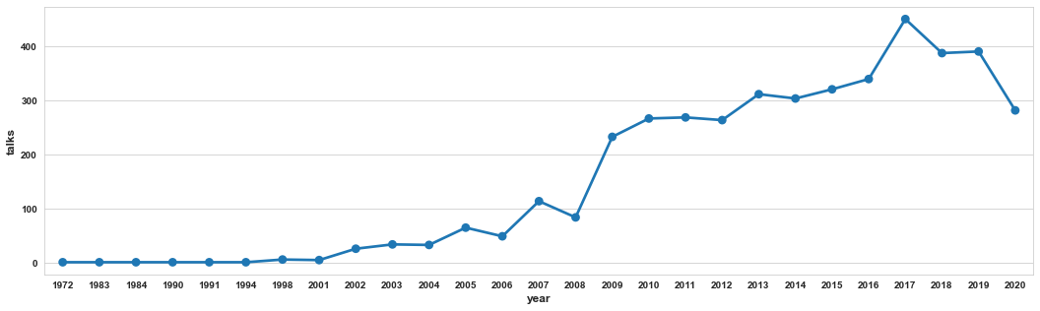
Is it worth it? TED Growth over the years

Slide 4
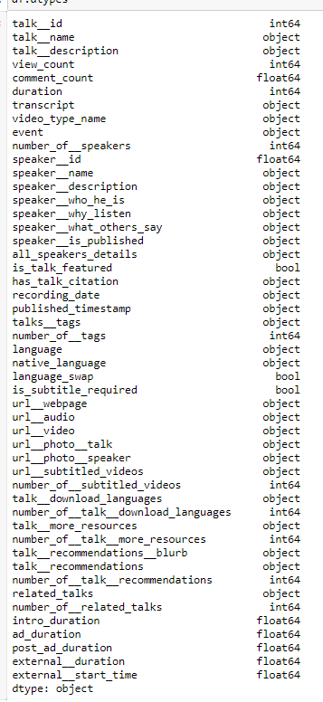
Data Acquisition and description
We have used a python-based scrapper to scrap TED.com for all the information it is offering on the talks from different conferences made available on the website.
We managed to collect data on different 4928 TED talks and videos (from TED-Ed which are not technically a talk) with the first talk being filmed on 1972 and the most recent one being on the 10th of December 2020 and published on 11th of January 2021
For each talk, we have acquired 49 attributes (features) from which we have chosen a subset to perform our analysis on

Slide 5
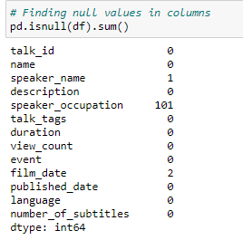
Data Cleaning
Luckily, the scraped data did not have a lot of null values, only one or two entries in the chosen columns that we have either decided to drop and/or substitute.
We dropped the entries with null values as the speaker name and film date.
The null values in the speaker’s occupation column are substituted with “unknown.”
We have also removed all talks falling under TED-Ed event since they are short, animated videos and not technically “The Talk” we are aiming to analyze.
All videos with zero views were replaced with the next minimum value of views since we have assumed that these videos had very low views that TED preferred not to provide them.
Let’s Start Our Analysis!

Slide 6
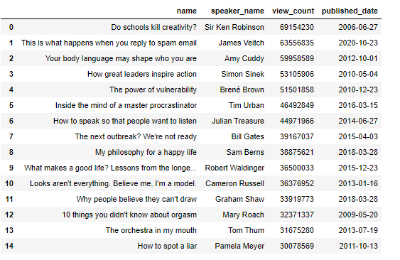
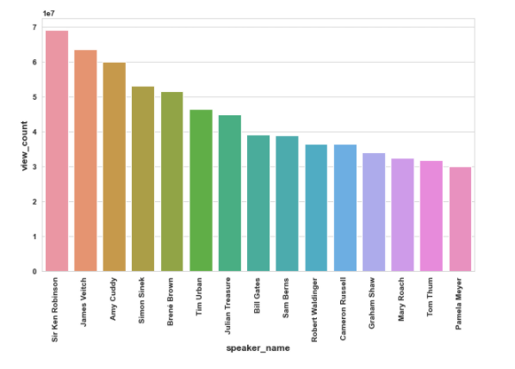
First Step is to Know the competition
Do schools kill creativity? by Sir Ken Robinson is the most viewed talk with almost 70 million views and nearly 20 million of them is in the years between 2018 till 2021
Bill Gates' talk about the pandemic is in 7th place with nearly 40 million views . This talk was not even in the top 10 talks in 2017 and only had 2.2 million , even though there have been other talks in 2015 that made it to the top 10 in 2017

Slide 7
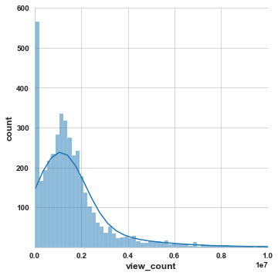
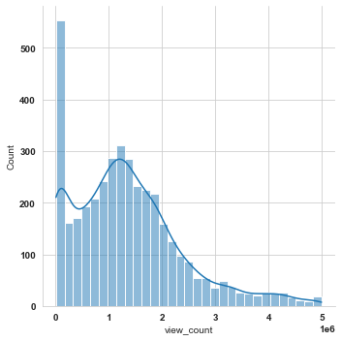

First Step is to Know the competition
Okay, so the competition is tough, but aren't all worthy competitions are? let us investigate the summary statistics and the distribution of the views on various TED Talks.
The average number of views on TED Talk videos is nearly 2 millions and the median is 1.3 million. TED IS popular. If you ace your TED talk, your ideas will reach a large number of people.

Slide 8

How much time do you have to be prepared?

Slide 9
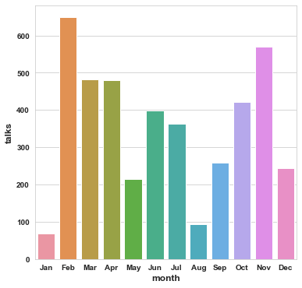
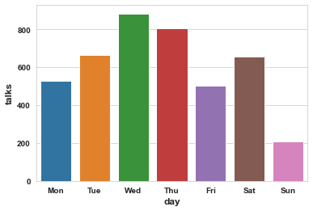
How much time do you have to be prepared?

Slide 10
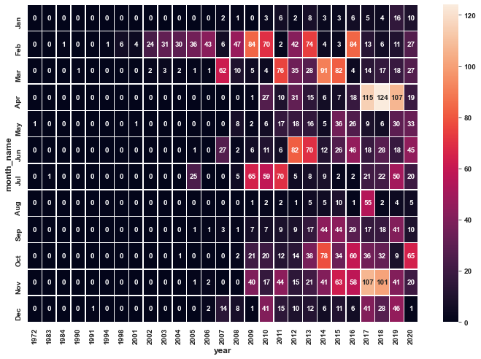
How much time do you have to be prepared?

Slide 11
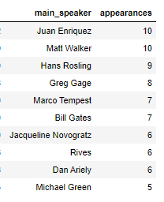
Who are the people who are most invited to TED?
Juan Enriquez the mexican-amercian businessman and author along with Matt Walker the English scientist and professor of neuroscience and psychology at the University of California are have the most talks on TED and Hans Rosling the Swedish physician comes third.
Interestingly, Matt Walker was not even in the top 10 speakers in 2017.

Slide 12
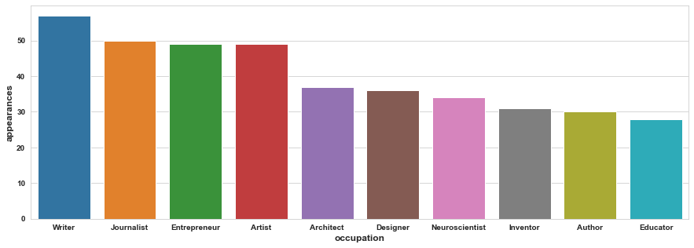
Who are the people who are most invited to TED?

Slide 13
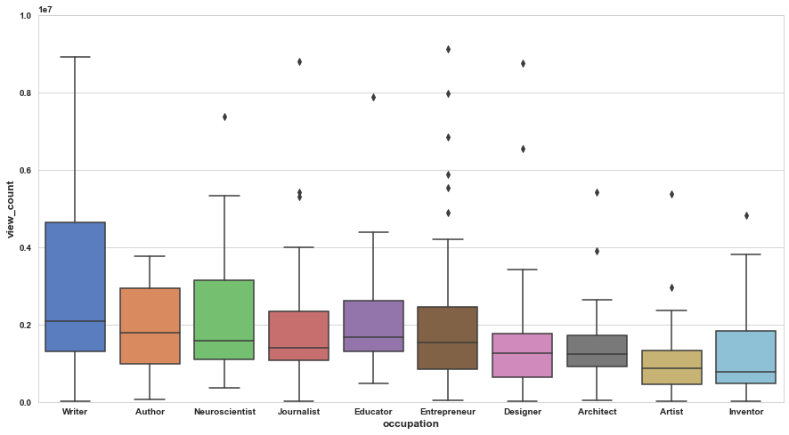
Who are the people who are most invited to TED?

Slide 14
Who are the people who are most invited to TED?
On average, out of the top 10 most popular professions, Writers tend to have the most views and have the greatest range of views
Entrepreneurs do not give talks with a large number of views except for a few outliers. That is a bit surprising to us as we thought that a big part of being an entrepreneur is being able to give convincing and touching talks. But this philosophical question is may be for another time.
It also appears that identifying yourself as an Inventor does not automatically guarantee you a large number of views.

Slide 15
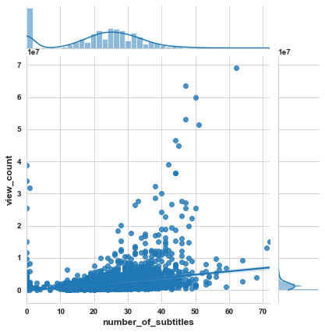
Do you need to hire translators?
As it appears, there is not that much of strong correlation between number of subtitles available for a given talk and its number of views. Content quality seems to be dominant in TED talks.
Pearson coefficient = 0.3463540470931365

Slide 16
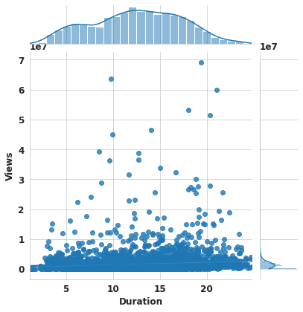
How long should you take?
There seems to be almost no correlation between these two quantities. Content is king at TED.
Pearson coefficient = 0.06800159342954752

Slide 17

What should your talk be about?

Slide 18
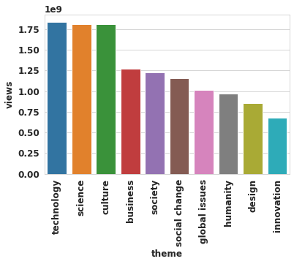
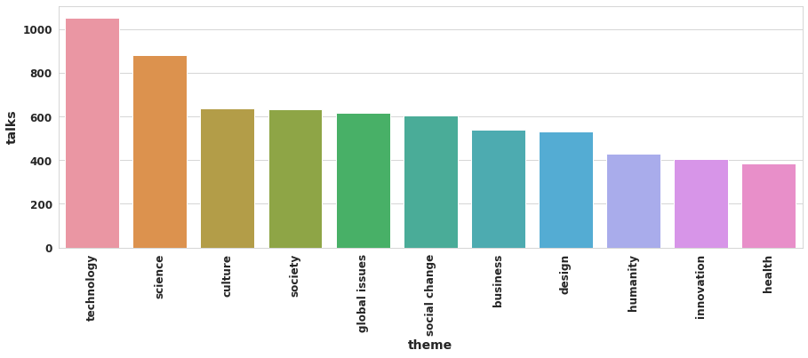
What should your talk be about?
As may have been expected, Technology is the most popular topic for talks, followed by science and culture
By comparing these results with the results of 2017, it semes that the interest of viewers in global issues have decreased as it ranked third in 2017. We believe that this because of the uprising of conspiracy theories and people may have had enough of people telling them about the end of the world.

Slide 19
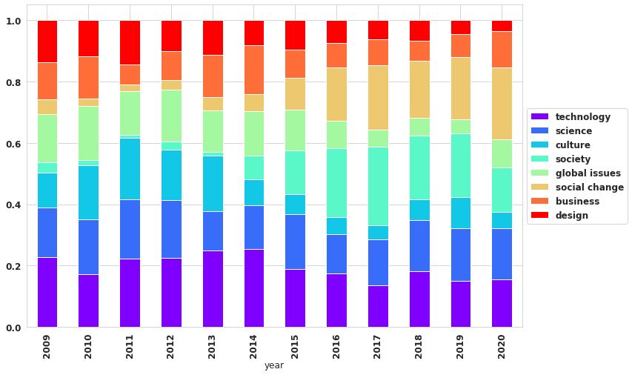
What should your talk be about?

Slide 20
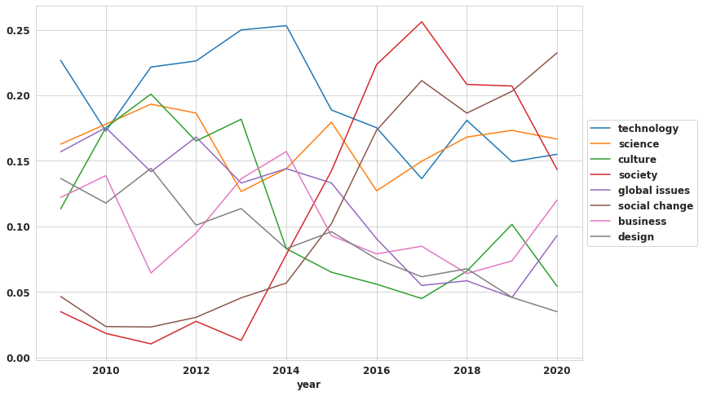
What should your talk be about?
It appears that the number of talks about science is most stable throughout the years.
Talks about technology have been decreasing over the years but it appears to be re-gaining momentum
Society has spiked from 2013 till 2017 and then began to decline again

Slide 21

Are there any magic words?

Slide 22
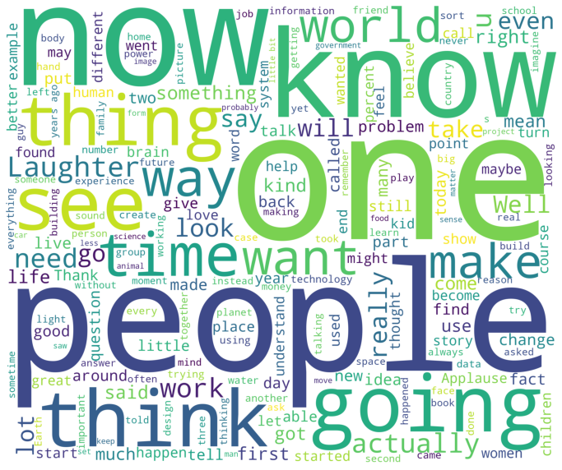
Are there any magic words?
We have constructed a word cloud from the available transcripts, which are 4359 transcripts.
The words one, now and people are the most popular words across the corpus of all TED Transcripts which we think encapsulates the idea of TED well. TED speeches seem to place a lot of emphasis on knowledge, insight, the present and of course, the people.

Slide 23
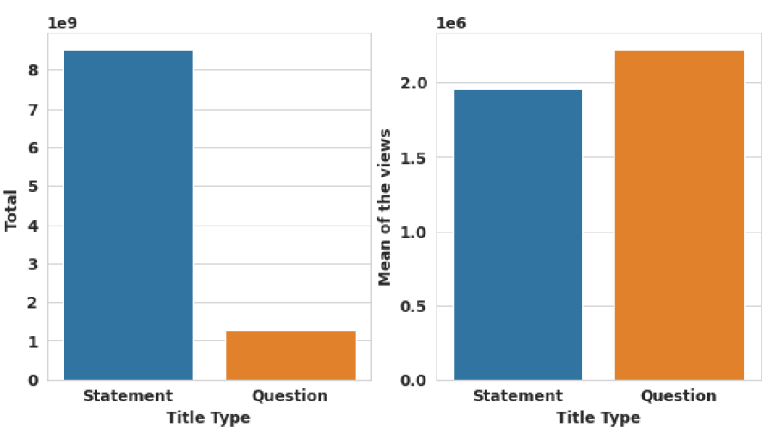
Make a Statement or Ask a Question?

Slide 24
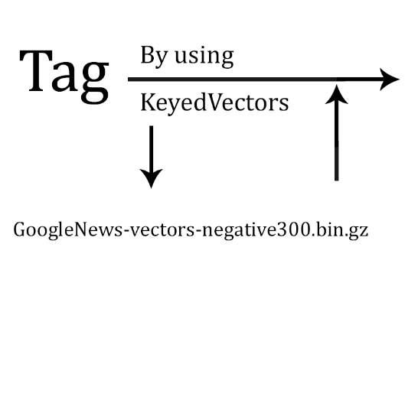
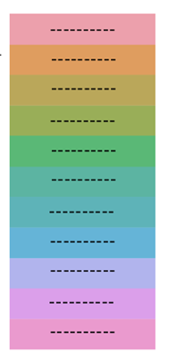
Categorizing the talks according to its tags

Slide 25
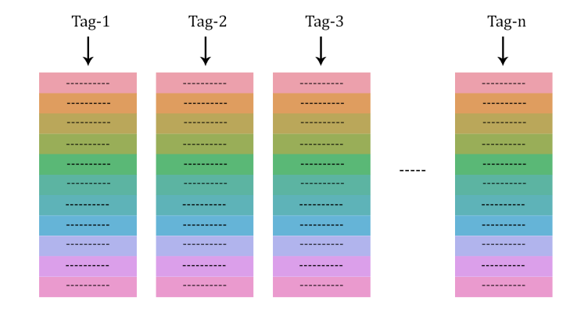
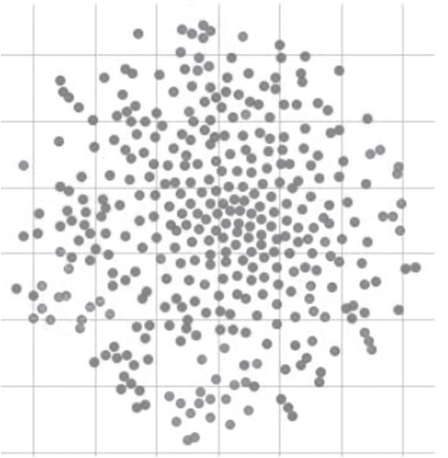
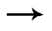
Categorizing the talks according to its tags
Reducing the Dimensions?
PCA

Slide 26
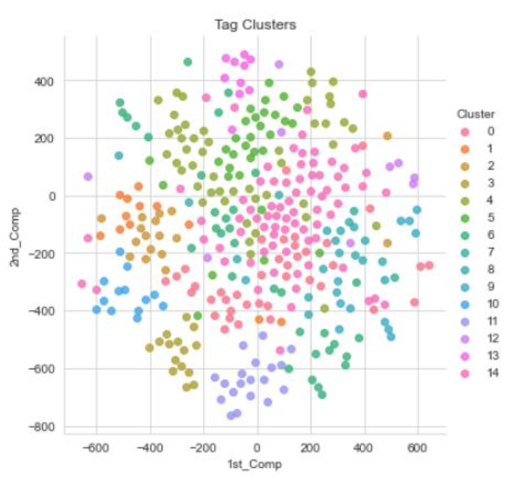
Categorizing the talks according to its tags
K-Means Clustering

Slide 27
Most Observed Categories
Economics/Business Category
Global issues Category
Exploration Category
Humanity/Progress Category
Music Category
Scientific Fields Category
Technology/Computer Category
Ecology Category, Epidemics Category
Philanthropy/Religion Category
Arts Category
Animals/Organisms Category
Social Category
Media/Entertainment Category
Let’s start prediction!

Slide 28





Prediction
What are the features that we should consider in the prediction?
Duration
Type Name
Speaker Name
Number of related views
Published time month
Published time day
Published time year
The talk’s categories
Number of categories
Note: During Regression methods, We divided the data into two groups: 80% for training and 20% for testing.

Slide 29
Random Forest Regression
Extra Trees Regression
Regression Techniques
XGBoost Regression
LightGBM Regression

Slide 30
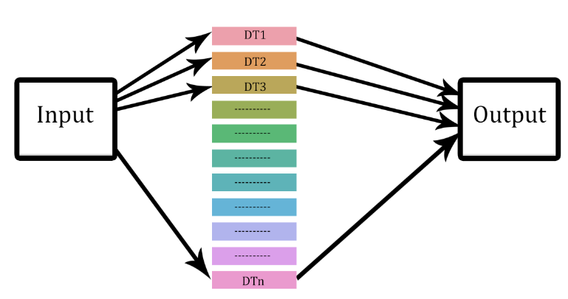
Random Forest Regression & Extra Trees Regression

Slide 31
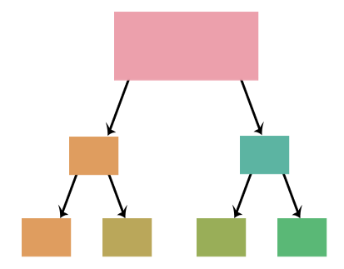
Random Forest Regression & Extra Trees Regression
X > known
threshold
X > random
threshold
yes
no
yes
no
The Decision Tree Threshold

Slide 32
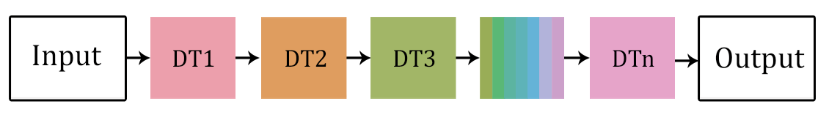
XGBoost Regression & LightGBM Regression

Slide 33
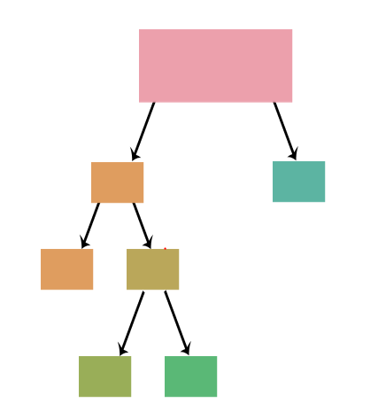
XGBoost Regression & LightGBM Regression
Level-wise tree growth
Leaf-wise tree growth

Slide 34
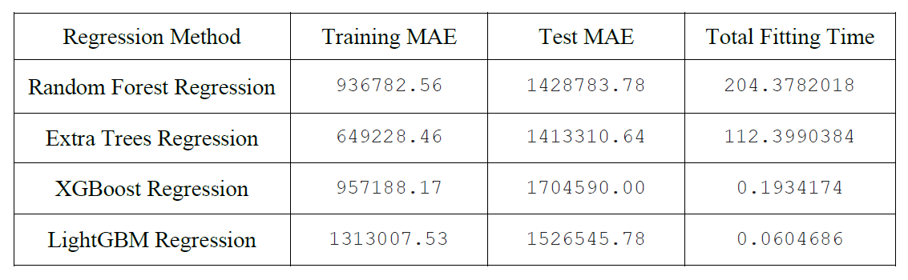
Regression Results
To compare between regression methods, we care about Accuracy and Time

Slide 35
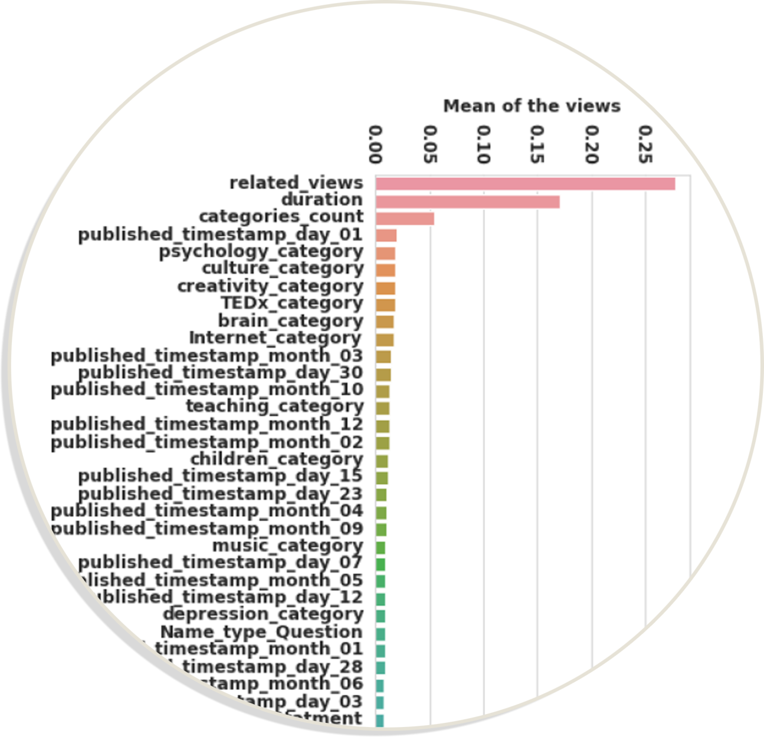
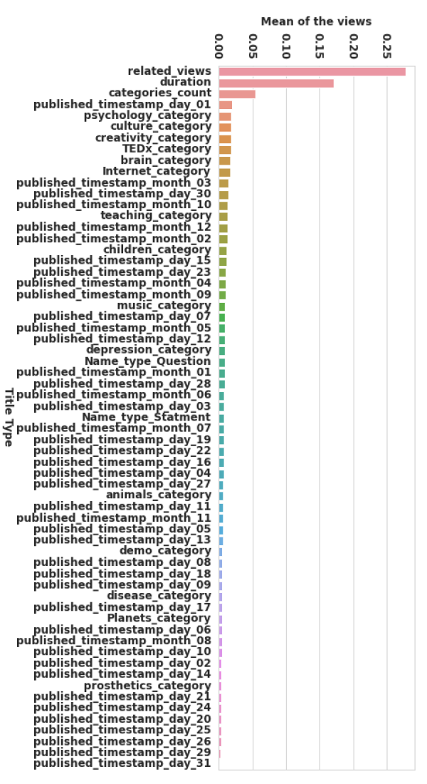
Most Important Features

Slide 36
ANY Questions?

